Slide 1
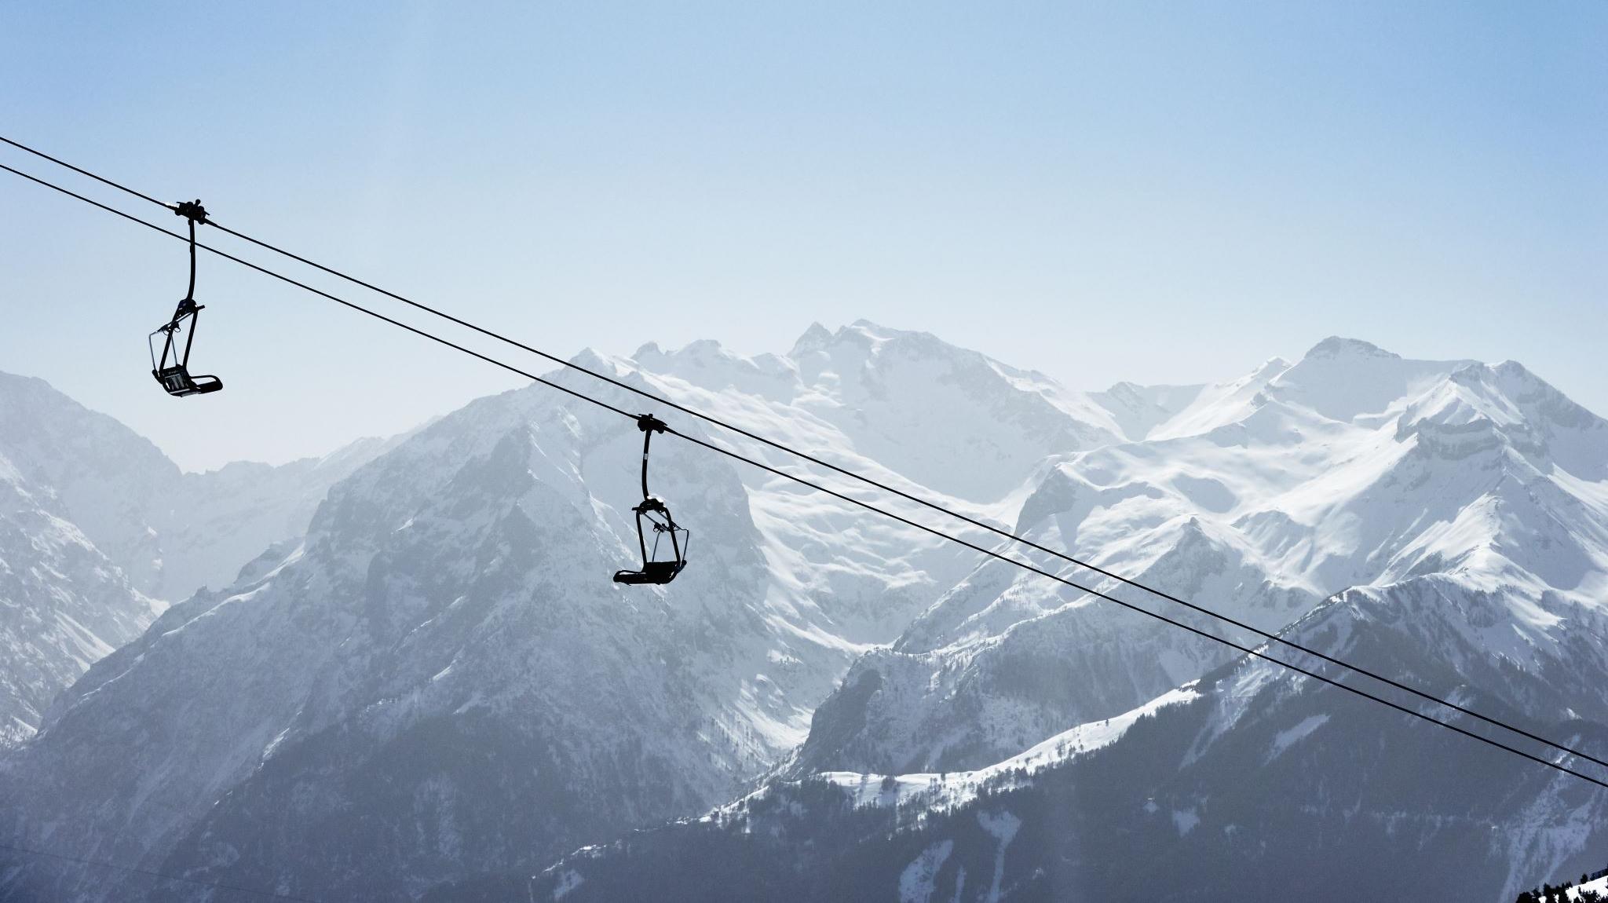
Big Mountain Ski Resort

Slide 2
Purpose of this project
Guidance on pricing strategies and future investments for ski resorts. This includes creating a pricing model specifically for ski resort tickets within their market segment and developing a predictive model to estimate ticket prices.
Additionally, provide insights into the significance of different facilities to visitors and identify the facilities that are most likely to attract their interest and willingness to pay.

Slide 3
Closing run
Closing up to 10 of the least used runs will implement the closure of up to 10 of the least used runs may help optimize operational costs and resources. However, it's important to evaluate the potential impact on customer satisfaction and overall experience. Adjusting the ticket prices and revenue projections accordingly would depend on factors such as the demand for those runs and the potential cost savings from their closure.
Closing up to 5 runs could result in a decrease in ticket prices and revenue due to reduced offerings for customers. The decrease in ticket prices is intended to incentivize visitors to compensate for the fewer available runs. However, careful consideration should be given to balancing the potential loss in revenue with maintaining a satisfactory experience for visitors.

Slide 4
Additional features
Increasing vertical drop by 150ft and adding a chair lift: The addition of a chair lift and an increased vertical drop by 150ft can enhance the skiing experience and attract more visitors. Justifying a ticket price increase of $8.67 and projecting an additional revenue of $15 million takes into account the added value and improved customer satisfaction resulting from these investments.
Adding 2 acres of snowmaking: Incorporating an additional 2 acres of snowmaking can ensure better snow conditions and extend the ski season. This enhancement can be justified by increasing the ticket prices by $10.59 and projecting an additional revenue of $18.5 million. The increased revenue reflects the improved quality of the skiing experience and the potential increase in visitor numbers.

Slide 5
Additional features
Increasing the longest run by 0.2 miles and adding 4 acres of snowmaking: Expanding the longest run by 0.2 miles and adding 4 acres of snowmaking can enhance the resort's offering without necessitating a change in ticket prices. This improvement aims to attract more visitors and enhance the overall experience, while maintaining the current ticket pricing structure.

Slide 6
Recommendation
By implementing an increase in vertical drop by 150ft, along with the installation of a chair lift and the addition of 2 acres of snowmaking, the ski resort can justify a ticket price increase of $10.59. This strategic enhancement is expected to generate an additional revenue of $18.5 million per year. The improved skiing experience, facilitated by the increased vertical drop and accessibility provided by the new chair lift, coupled with enhanced snowmaking capabilities, is anticipated to attract more visitors and increase overall revenue for the resort.

Slide 7
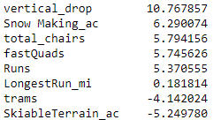
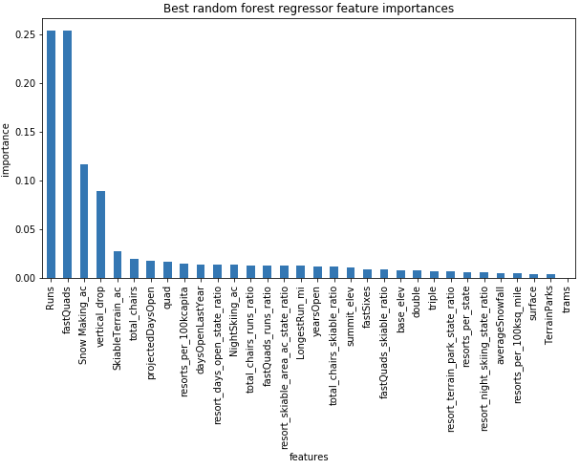
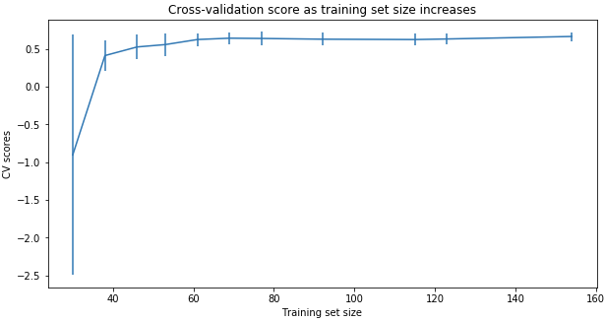
Modeling Comparison
Linear Regression Model vs. Random Forest Regression Model
( MAE, std) 10.499, 1.622 vs. 9.649, 1.505
Cross-Validation Score
Notes:
The random forest model has a lower cross-validation mean absolute error (MAE errors between paired observations expressing the same phenomenon) by almost $1. It also exhibits less variability. Verifying performance on the test set produces performance consistent with the cross-validation results. (10.499032338015294, 1.6220608976799664) vs. (9.649477185159107, 1.505326312688125)
This shows that you seem to have plenty of data. There's an initial rapid improvement in model scores as one would expect, but it's essentially levelled off by around a sample size of 40-50

Slide 8
Modeling Data
The modelled price for Big Mountain ski resort is $95.86, while the actual price is $81.00. With a mean absolute error (MAE) of $10.36, the analysis suggests that there is room for a potential increase in ticket prices.

Slide 9
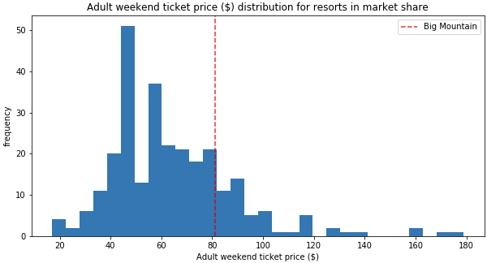
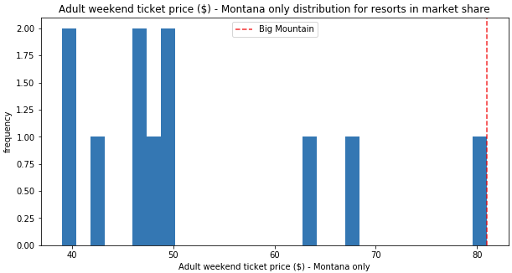
Big Mountain Resort Ticket Prices

Slide 10
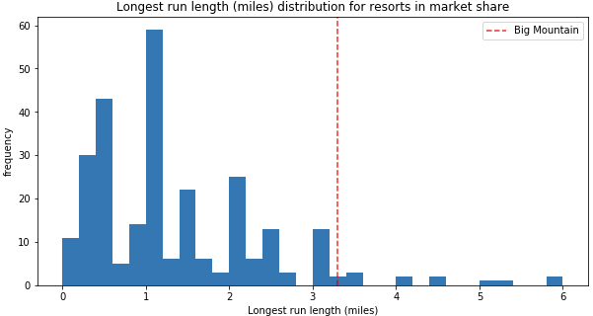
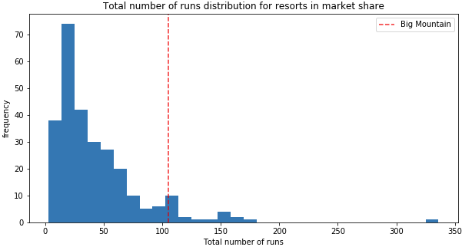
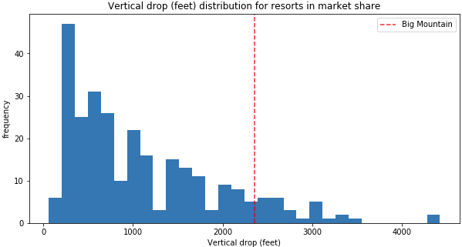
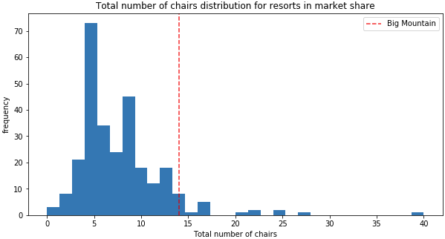
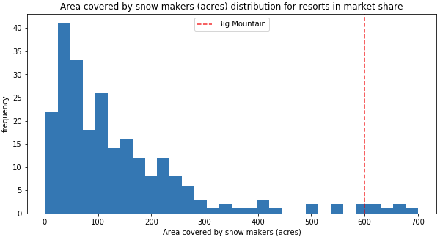
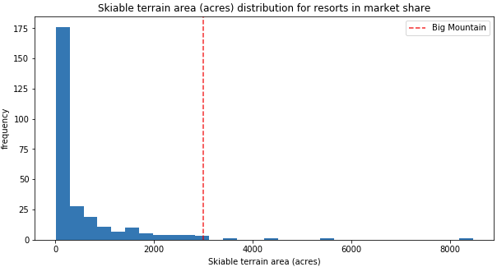
Feature Comparisons

Slide 11
Conclusion
Big Mountain is currently recognized as one of the top resorts, thanks to its impressive features and offerings. Key factors contributing to its reputation include:
Skiable Terrain: Big Mountain boasts a substantial skiable terrain, providing visitors with ample space to enjoy their skiing and snowboarding activities.
Number of Runs: The resort offers a diverse range of runs, catering to various skill levels and preferences of its guests.
Snowmaking Capacity: Big Mountain's snowmaking capacity ensures consistent and reliable snow conditions, even during periods of lower natural snowfall.
Number of Chairs: The resort provides multiple chair lifts, allowing efficient and convenient access to different parts of the mountain.

